Slide 1
Lagan Valley Regional Park
Counter data
Survey questionnaire
Section 1
When and why visit LVRP
User Survey 2022
Section 2
People who use LVRP
Section 3
Attitudes and Perceptions
Comparative study

Slide 2
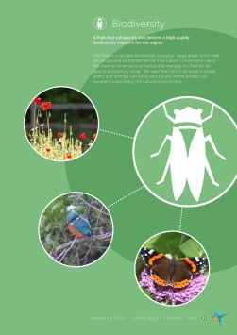
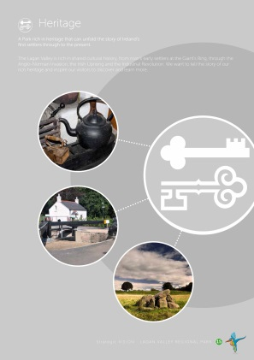
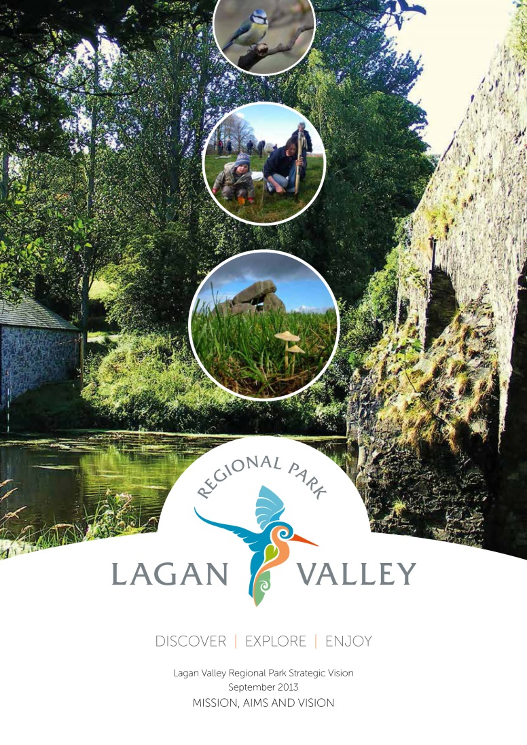
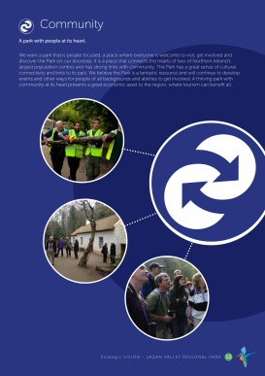
Lagan Valley Regional Park
Key Focus areas:
Biodiversity
Visitors
Community
Landscape
Heritage
Health and recreation

Slide 3
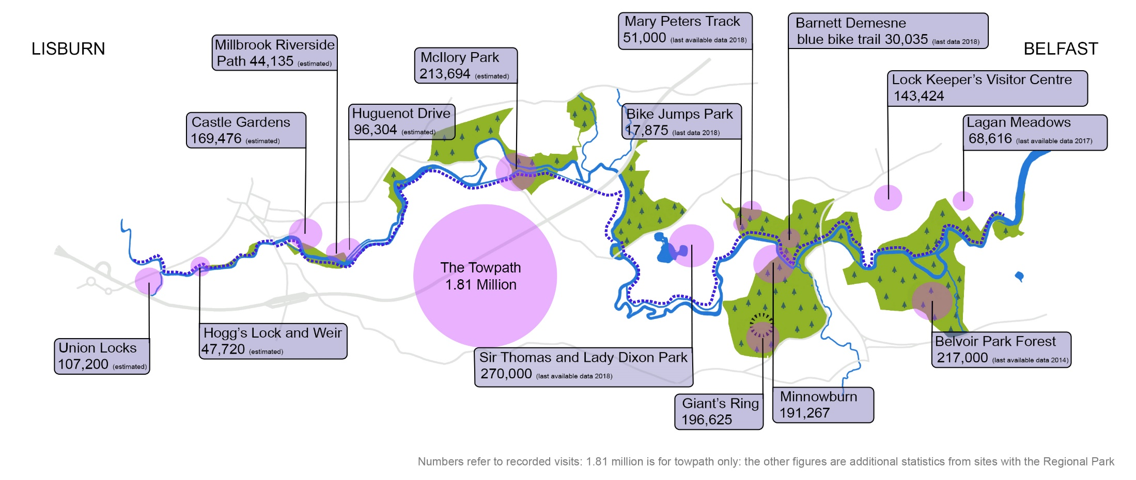
Lagan Valley Regional Park
Counter data
Overview across park 2021 can we put data in for 2022?

Slide 4
Lagan Valley Regional Park
Counter data

Slide 5
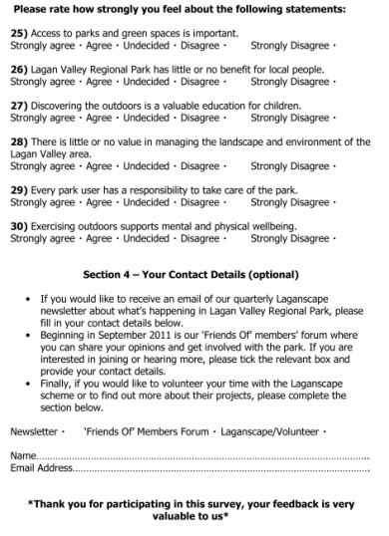
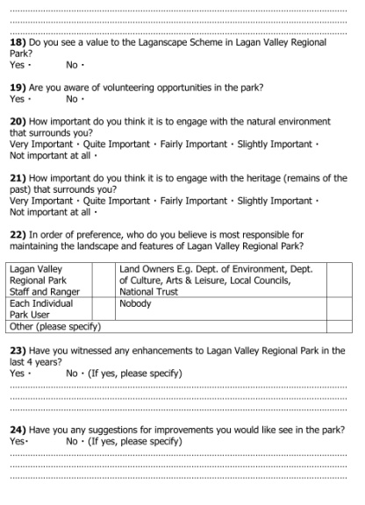
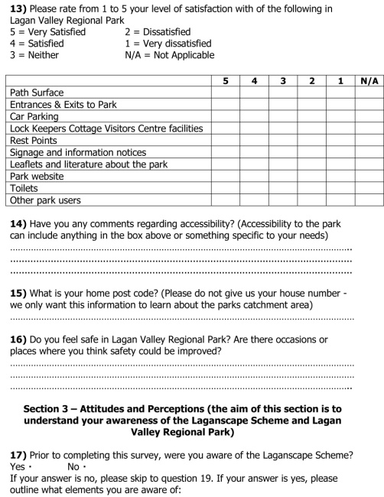
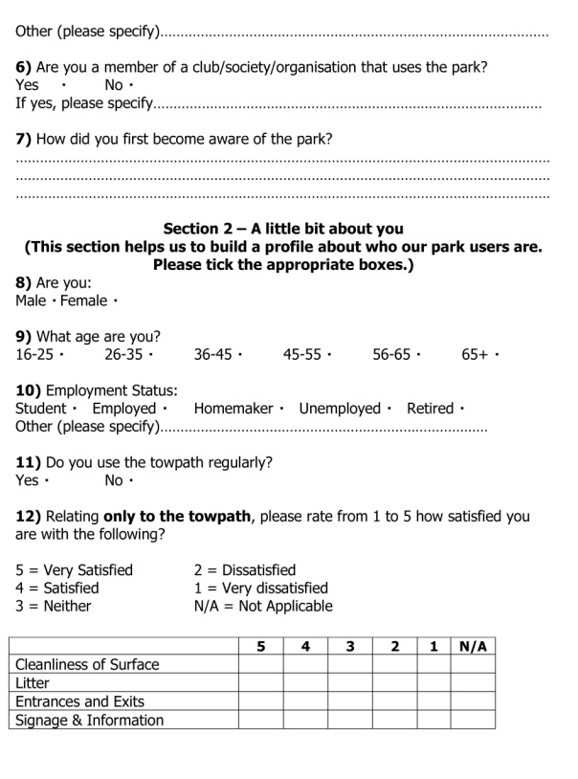
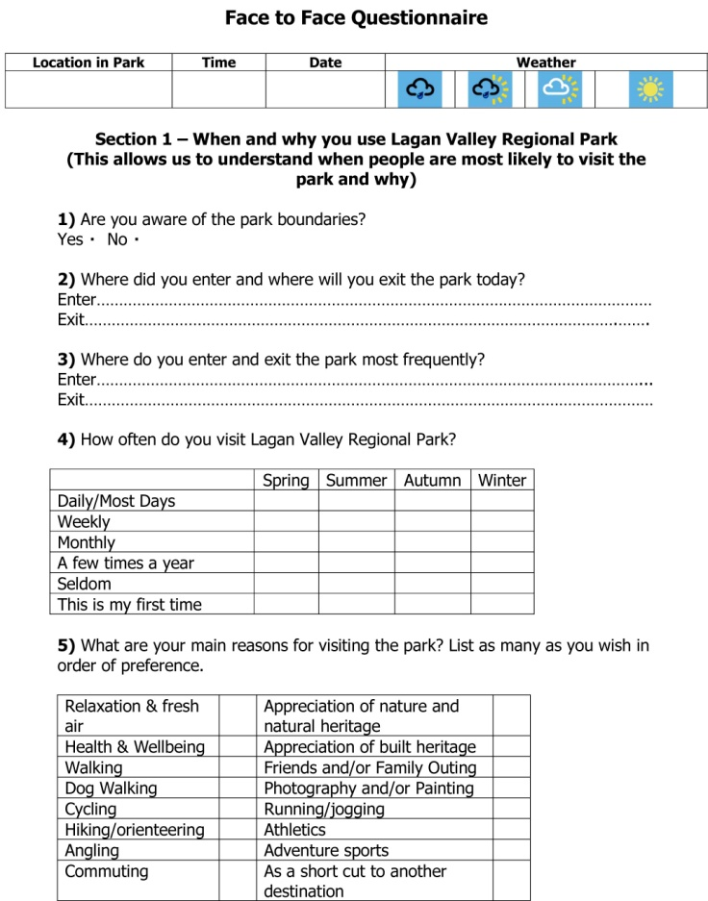
Lagan Valley Regional Park
The Survey
Survey
27 hours staff time
46 hours volunteer time
30 Questions
Website, fb and Survey Monkey
Survey sample size 77
Count sample size 1456
August – October 2022
Analysis
42 hours staff time

Slide 6
Lagan Valley Regional Park
Survey questionnaire
Section 1
When and why visit LVRP
This allows us to understand when people are most likely to visit Lagan Valley Regional Park and why
User Survey 2022

Slide 7
Lagan Valley Regional Park
Survey questionnaire
Q1 Are you aware of the Park boundaries? Yes
No
Q2 Entry points
Q3 Exit points

Slide 8
Lagan Valley Regional Park
Survey questionnaire
Q4 How often do you visit LVRP?
Q5 Main reasons for visiting the Park- ranked according to popularity

Slide 9
Lagan Valley Regional Park
Survey questionnaire
Q6 Member of club or organisation? Yes
No
Q7 How did you become aware of the Park?

Slide 10
Lagan Valley Regional Park
Survey questionnaire
Section 2
People who use LVRP
This section helps us to build a profile about who uses Lagan Valley Regional Park
User Survey 2022

Slide 11
Lagan Valley Regional Park
Survey questionnaire
Q9 Age profile
Q8 Gender profile
Under 18
19 to 39
40 to 65
Over 65
Q10 Employment status
Employed FT
Employed PT
Student
Unemployed
Retired
User types from count (1456)
Other

Slide 12
Lagan Valley Regional Park
Survey questionnaire
Q12 Satisfaction with towpath
Q11 Frequency of use towpath
Daily
Weekly
Monthly
Less
Q13 Satisfaction with Regional Park
Very Satisfied 5
Satisfied 4
Neither 3
Dissatisfied 2
Very Dissatisfied 1

Slide 13
Lagan Valley Regional Park
Survey questionnaire
Q14 Perception of safety – do you feel safe?
Q15 Have you any comments regarding accessibility?
Yes
No
Yes
No

Slide 14
Lagan Valley Regional Park
Survey questionnaire
Q16 Where visitors come from?

Slide 15
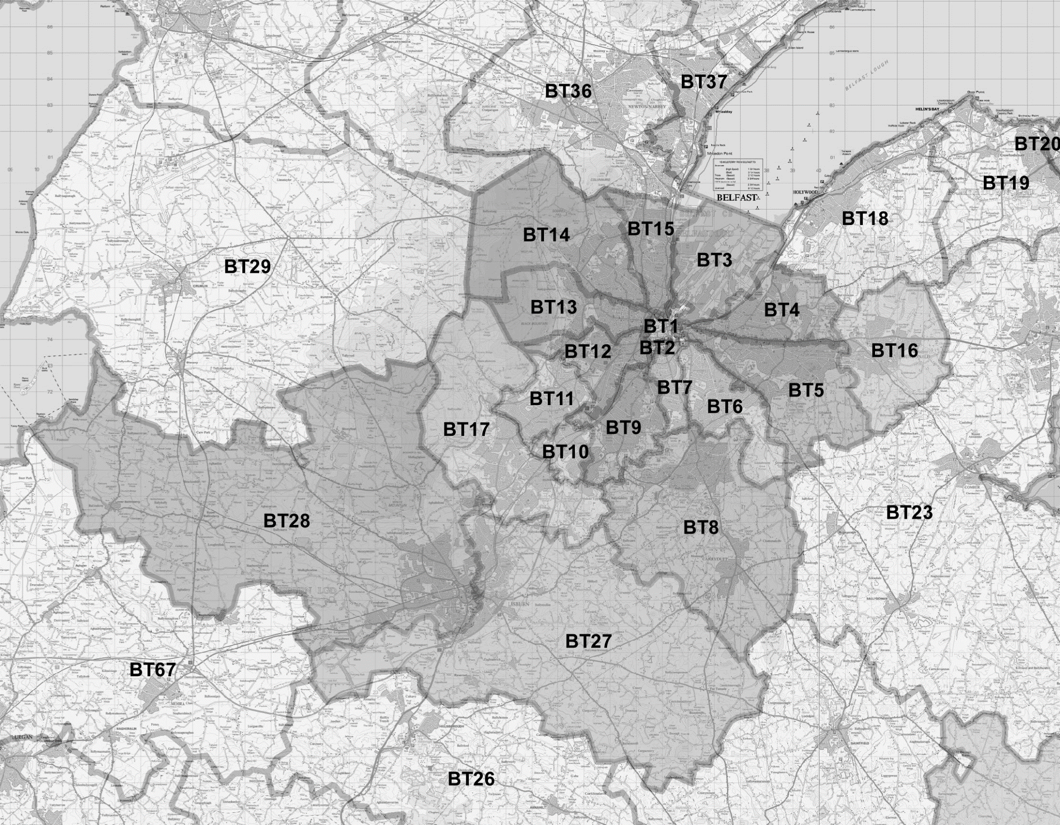
Lagan Valley Regional Park
Survey questionnaire
BT30

Slide 16
Lagan Valley Regional Park
Survey questionnaire
Q17 Where did you visit today?
Towpath 1 (Stranmillis to Shaws Bridge)
Towpath 2 (Shaws Bridge to Drumbridge)
Towpath 3 (Drumbridge to Lambeg)
Towpath 4 (Lambeg to Lagan Valley Island)
Towpath 5 (Lagan Valley Island to Blaris Road)

Slide 17
Lagan Valley Regional Park
Survey questionnaire
Section 3
Attitudes and Perceptions
This section aims to understand peoples awareness of the Lagan Valley Regional Park and what we do.
User Survey 2022

Slide 18
Lagan Valley Regional Park
Survey questionnaire
Q18 Aware of volunteering opportunities
in the Park?
Q20 Perceived responsibility for
Maintaining landscape and
features of LVRP?
Yes
Q19 Would like to get involved in volunteering?
Yes

Slide 19
Lagan Valley Regional Park
Survey questionnaire
Q21 Engaging with the natural environment?
Q22 Engaging with built heritage?

Slide 20
Lagan Valley Regional Park
Q24 Have you any suggestions
for improvements?
Survey questionnaire
Q23 Have you noticed any
enhancements or improvements?
Yes
Yes

Slide 21
Lagan Valley Regional Park
Survey questionnaire
Q25 Access to parks and open spaces is important.
Q26 Lagan Valley Regional Park has little or no benefit for local people.
Q27 Discovering the outdoors is a valuable education for children.

Slide 22
Lagan Valley Regional Park
Survey questionnaire
Q28 There is little or no value in managing the landscape and environment of the Lagan Valley area.
Q29 Every park user has a responsibility to share, respect and enjoy the park and other park users.
Q30 Exercising outdoors supports mental and physical wellbeing.

Slide 23
Lagan Valley Regional Park
Comparative study
User Survey 2022

Slide 24
Lagan Valley Regional Park
Comparative study
User surveys have been carried out in:
1998
2001
2006
2009
2012
2017
2022
User numbers are also collected annually
Q. Which comparative data are most useful?

Slide 25
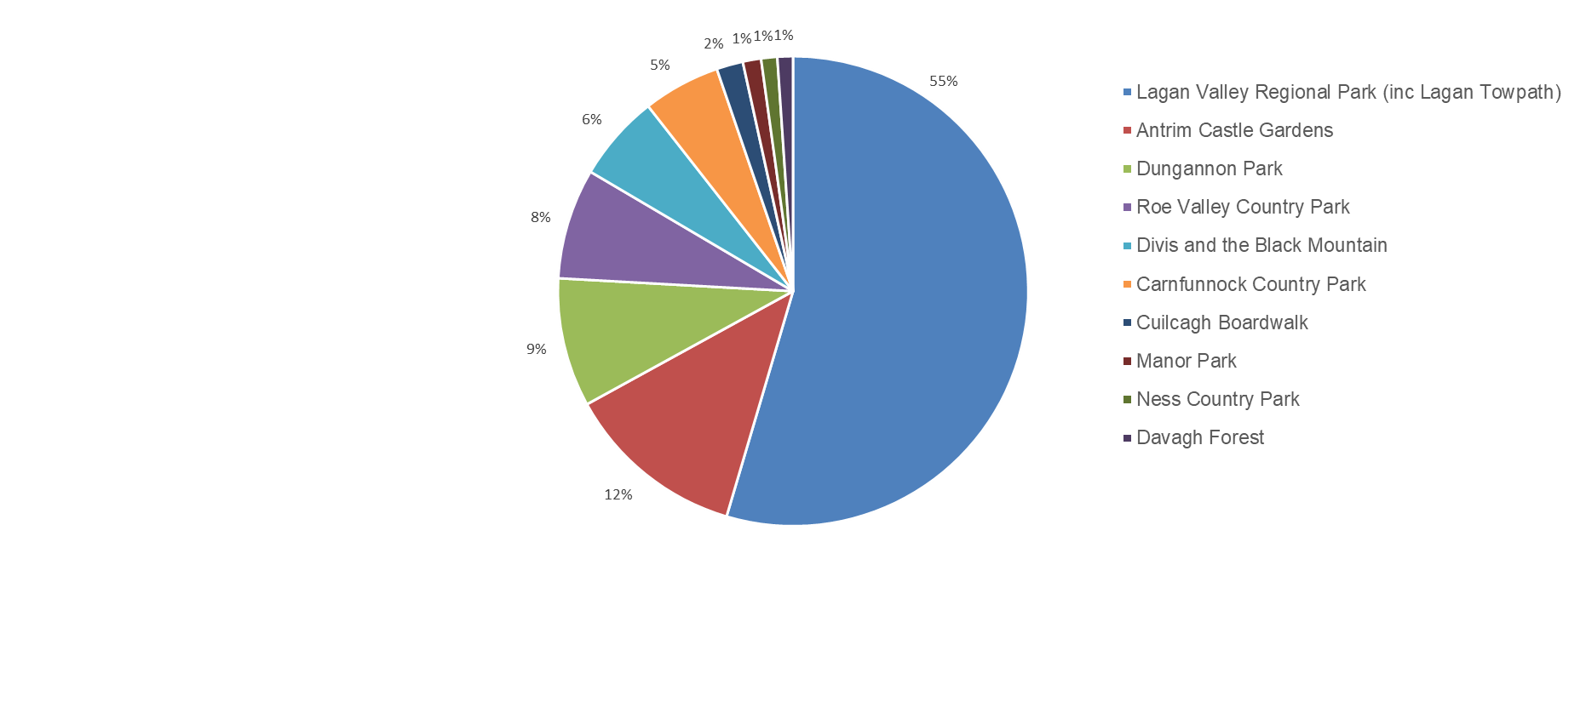
Lagan Valley Regional Park
Counter data
From towpath counters

Slide 26
Lagan Valley Regional Park
Comparative study
Comparative gender profile

Slide 27
Lagan Valley Regional Park
Comparative study
Comparative user types

Slide 28
Lagan Valley Regional Park
Comparative study
Changes in where visitors have come from

Slide 29
Lagan Valley Regional Park
Comparative study
2012
2017
2022
Comparative post codes

Slide 30
Lagan Valley Regional Park
Comparative study
Comparative age profile

Slide 31
Lagan Valley Regional Park
2012
Comparative study
2022
Comparative reasons for visiting LVRP
2017

